Slide 1
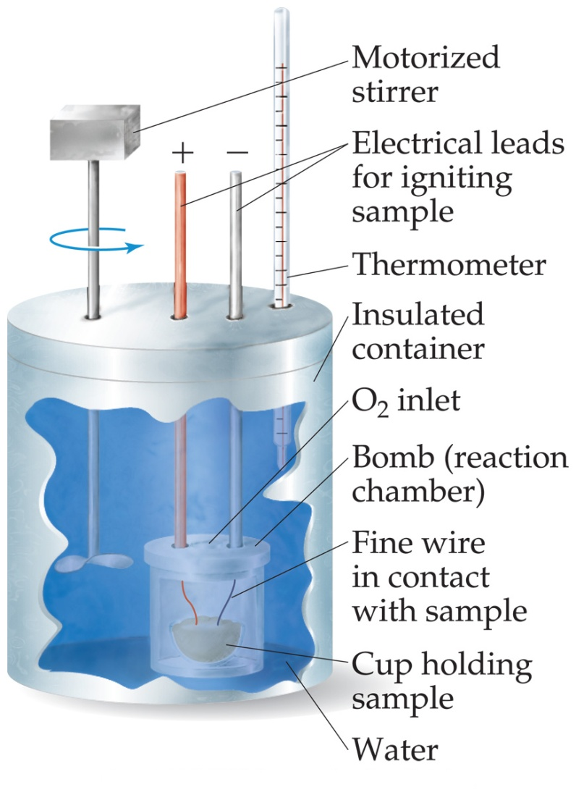
Bomb Calorimetry
Reactions can be carried out in a sealed “bomb” such as this one.
The heat absorbed (or released) by the water is a very good approximation of the enthalpy change for the reaction.

Slide 2
Bomb Calorimetry
Because the volume in the bomb calorimeter is constant, what is measured is really the change in internal energy, ΔE, not ΔH.
For most reactions, the difference is very small.

Slide 3
ΔH via Heat Capacity
q = C * ΔT
q = heat in Joules
C = heat capacity in J/K
ΔT = change in temperature
where ΔT = T_{f} – T_{i}
ΔH = q / # moles

Slide 4
Stoichiometric Determination of ΔΗ
Given the ΔH for a reaction, you can use mole ratios to determine ΔH values of different sample sizes.
See examples.

Slide 5
Sample Problem #1
H₂ (g) + I₂ (g) → 2 HI (g) ΔH = +53.0 kJ
How many joules of heat are required to form 5 moles of HI (g)?
5 mol HI __x___
2 mol HI = +53.0 kJ
x = +133 kJ

Slide 6
Sample Problem #2
H₂ (g) + I₂ (g) → 2 HI (g) ΔH = +53.0 kJ
How many moles of HI (g) are formed by the expenditure of 235 kJ of heat energy?
__x___ +235 kJ
2 mol HI = +53.0 kJ
x = 8.87 mol HI

Slide 7
Sample Problem #3
H₂ (g) + I₂ (g) → 2 HI (g) ΔH = +53.0 kJ
How many joules of heat are required to form 109 grams of HI?
# mol HI = mass/gfm
# mol HI = 109 g / 128 g/mol = 0.852 mol HI
0.852 mol HI __x___
2 mol HI = +53.0 kJ
x = + 22.6 kJ

Slide 8
Hess’s Law
ΔH is well known for many reactions, and it is inconvenient to measure ΔH for every reaction in which we are interested.
However, we can estimate ΔH using published ΔH values and the properties of enthalpy.

Slide 9
Hess’s Law
Hess’s law states that “If a reaction is carried out in a series of steps, ΔH for the overall reaction will be equal to the sum of the enthalpy changes for the individual steps.”
ΔH = ΔH₁ + ΔH₂ + ΔH₃

Slide 10
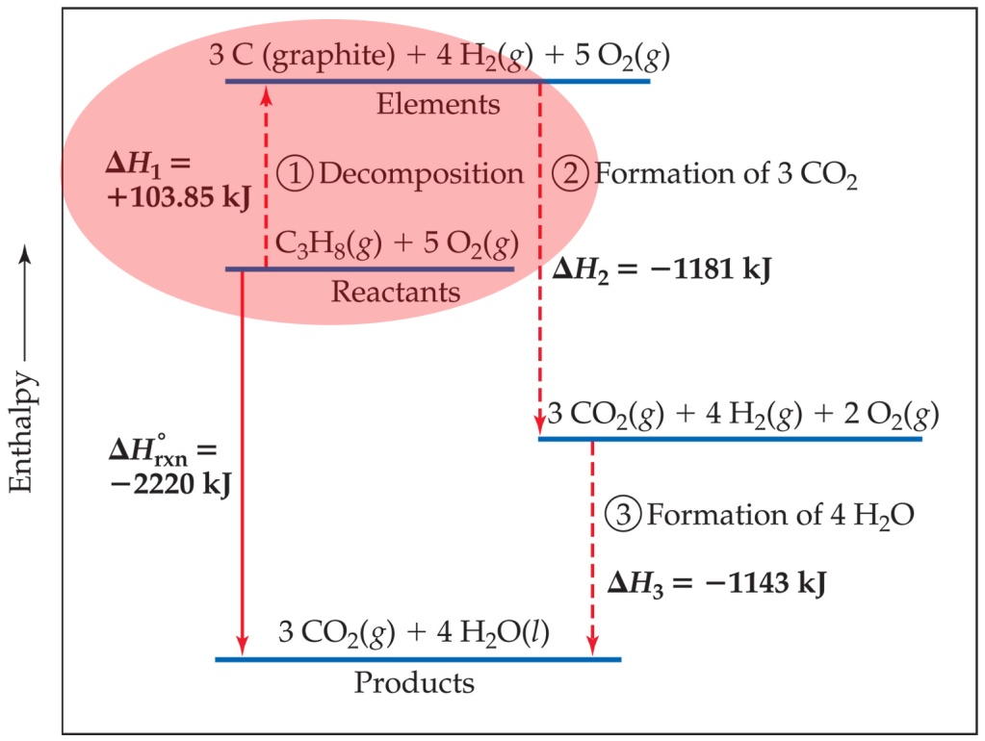
Calculation of ΔH
C₃H_{8 (g)} + 5 O_{2 (g)} ⎯→ 3 CO_{2 (g)} + 4 H₂O _{(l)}
Imagine this as occurring
in three steps:
C₃H_{8 (g)} ⎯→ 3 C _{(graphite)} + 4 H_{2 (g)}
3 C _{(graphite)} + 3 O_{2 (g)} ⎯→ 3 CO_{2 (g)}
4 H_{2 (g)} + 2 O_{2 (g)} ⎯→ 4 H₂O _{(l)}

Slide 11
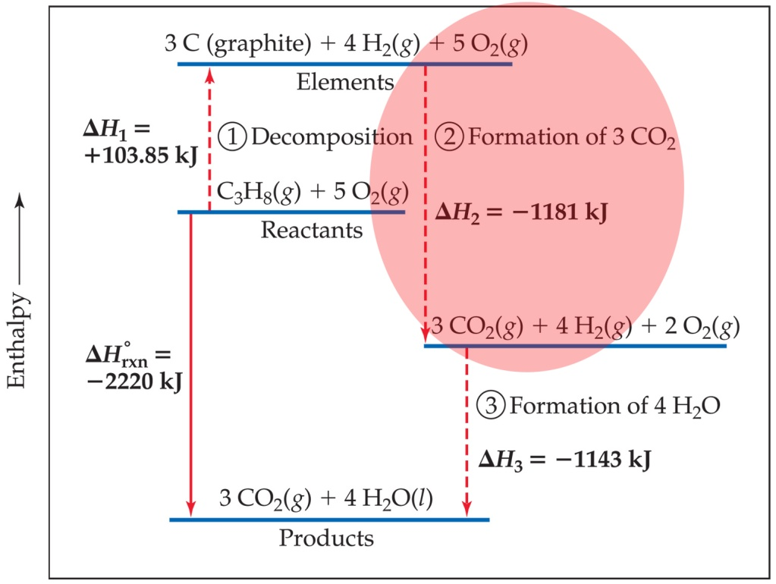
Calculation of ΔH
C₃H_{8 (g)} + 5 O_{2 (g)} ⎯→ 3 CO_{2 (g)} + 4 H₂O _{(l)}
Imagine this as occurring
in three steps:
C₃H_{8 (g)} ⎯→ 3 C _{(graphite)} + 4 H_{2 (g)}
3 C _{(graphite)} + 3 O_{2 (g)} ⎯→ 3 CO_{2 (g)}
4 H_{2 (g)} + 2 O_{2 (g)} ⎯→ 4 H₂O _{(l)}

Slide 12
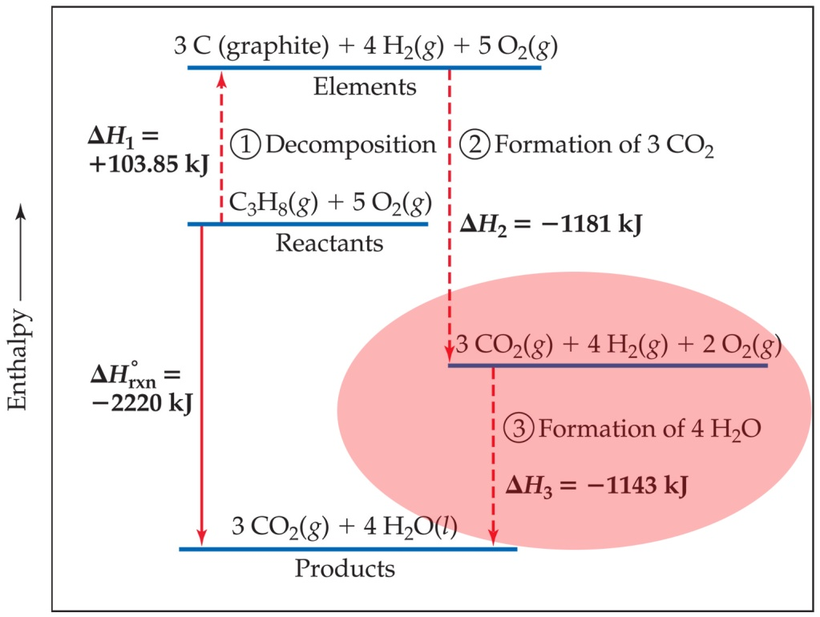
Calculation of ΔH
C₃H_{8 (g)} + 5 O_{2 (g)} ⎯→ 3 CO_{2 (g)} + 4 H₂O _{(l)}
Imagine this as occurring
in three steps:
C₃H_{8 (g)} ⎯→ 3 C _{(graphite)} + 4 H_{2 (g)}
3 C _{(graphite)} + 3 O_{2 (g)} ⎯→ 3 CO_{2 (g)}
4 H_{2 (g)} + 2 O_{2 (g)} ⎯→ 4 H₂O _{(l)}

Slide 13
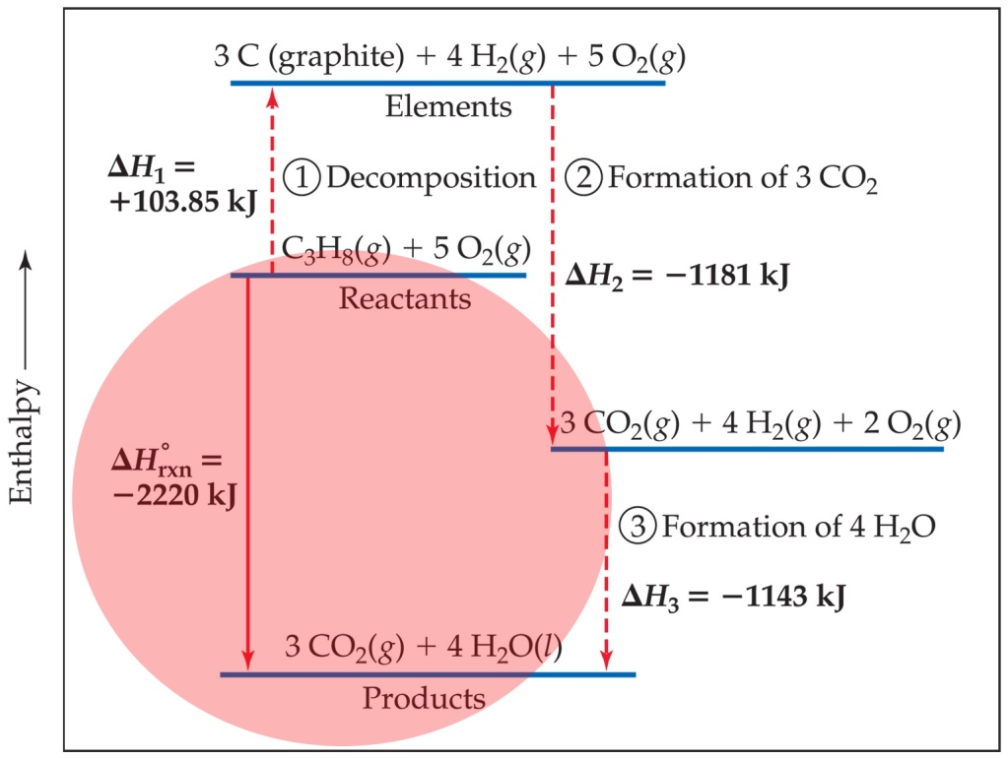
Calculation of ΔH
C₃H_{8 (g)} + 5 O_{2 (g)} ⎯→ 3 CO_{2 (g)} + 4 H₂O _{(l)}
The sum of these equations is:
C₃H_{8 (g)} ⎯→ 3 C _{(graphite)} + 4 H_{2 (g)}
3 C _{(graphite)} + 3 O_{2 (g)} ⎯→ 3 CO_{2 (g)}
4 H_{2 (g)} + 2 O_{2 (g)} ⎯→ 4 H₂O _{(l)}
C₃H_{8 (g)} + 5 O_{2 (g)} ⎯→ 3 CO_{2 (g)} + 4 H₂O _{(l)}

Slide 14
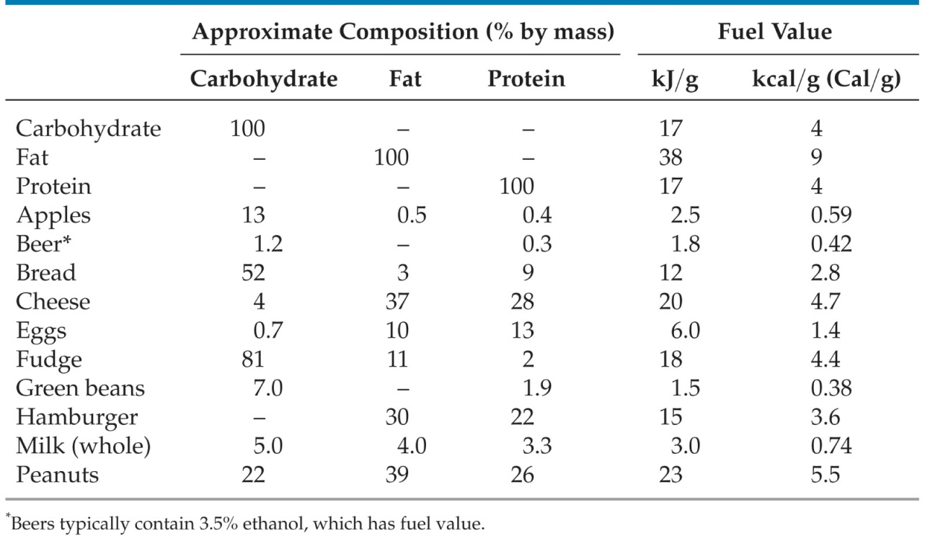
Energy in Foods
Most of the fuel in the food we eat comes from carbohydrates and fats.

Slide 15
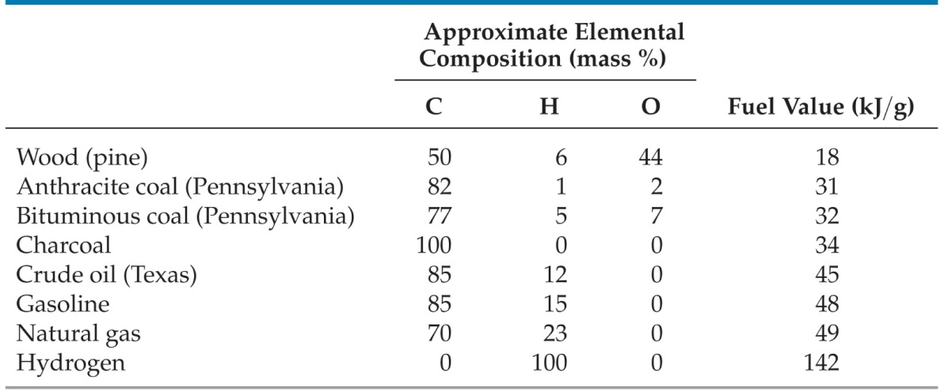
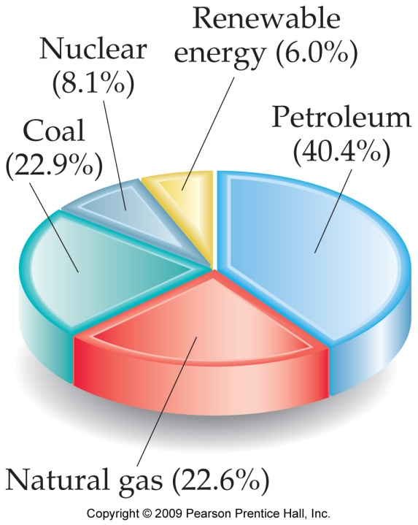
Energy in Fuels
The vast majority of the energy consumed in this country comes from fossil fuels.

Slide 16
Summary: Ways to Calculate ΔH
ΔH = Σ n ΔH_{f}°_{products} – Σ m ΔH_{f}° _{reactants}
Using ΔH_{f}º values from Appendix C
Or
By Using a Calorimeter
q_{reaction} = - q_{solution} = - m*sh*ΔT
where ΔT = T_{f} - T_{i} and m = D * V
ΔH = q_{reaction} /# moles

Slide 17
Summary: Ways to Calculate ΔH
Using Heat Capacity
q = C * ΔT
q = heat in Joules
C = heat capacity in J/K
ΔT = change in temperature
where ΔT = T_{f} – T_{i}
ΔH = q / # moles

Slide 18
Summary: Ways to Calculate ΔH
Hess’s Law
ΔH = ΔH₁ + ΔH₂ + ΔH₃
Or
By Stoichiometric Determination
Given the ΔH for a reaction, you can use mole ratios to determine ΔH values of different sample sizes.

